Slide 1
CMSC 304
Language Design Criteria & Abstractions in Programming Languages
Claire Sparks

Slide 2
Language Design Criteria
What is good programming language design?
What criteria should be used to judge a language?
How should success or failure of a language be defined?

Slide 3
Language Design Criteria
Criteria for a successful language:
  It achieves the goals of its designers
  It attains widespread use in an application area
  It serves as a model for other languages that are successful
Why are some languages popular when others are not?
  Ex: C with UNIX, COBOL in industry, Java & Python
  Ex: Smalltalk not, but many languages built from its constructs

Slide 4
Language Design Criteria
When creating a new language, decide on an overall goal and keep it in mind throughout the design process
This is especially important for special purpose languages
  The abstractions for the target application area must be built into the language design

Slide 5
Language Design Criteria
Focus Areas:
  Efficiency
  Security
  Regularity
    Generality
    Orthogonal Design
    Uniformity
  Extensibility
Notes:
We’re gonna go over these four focus areas

Slide 6
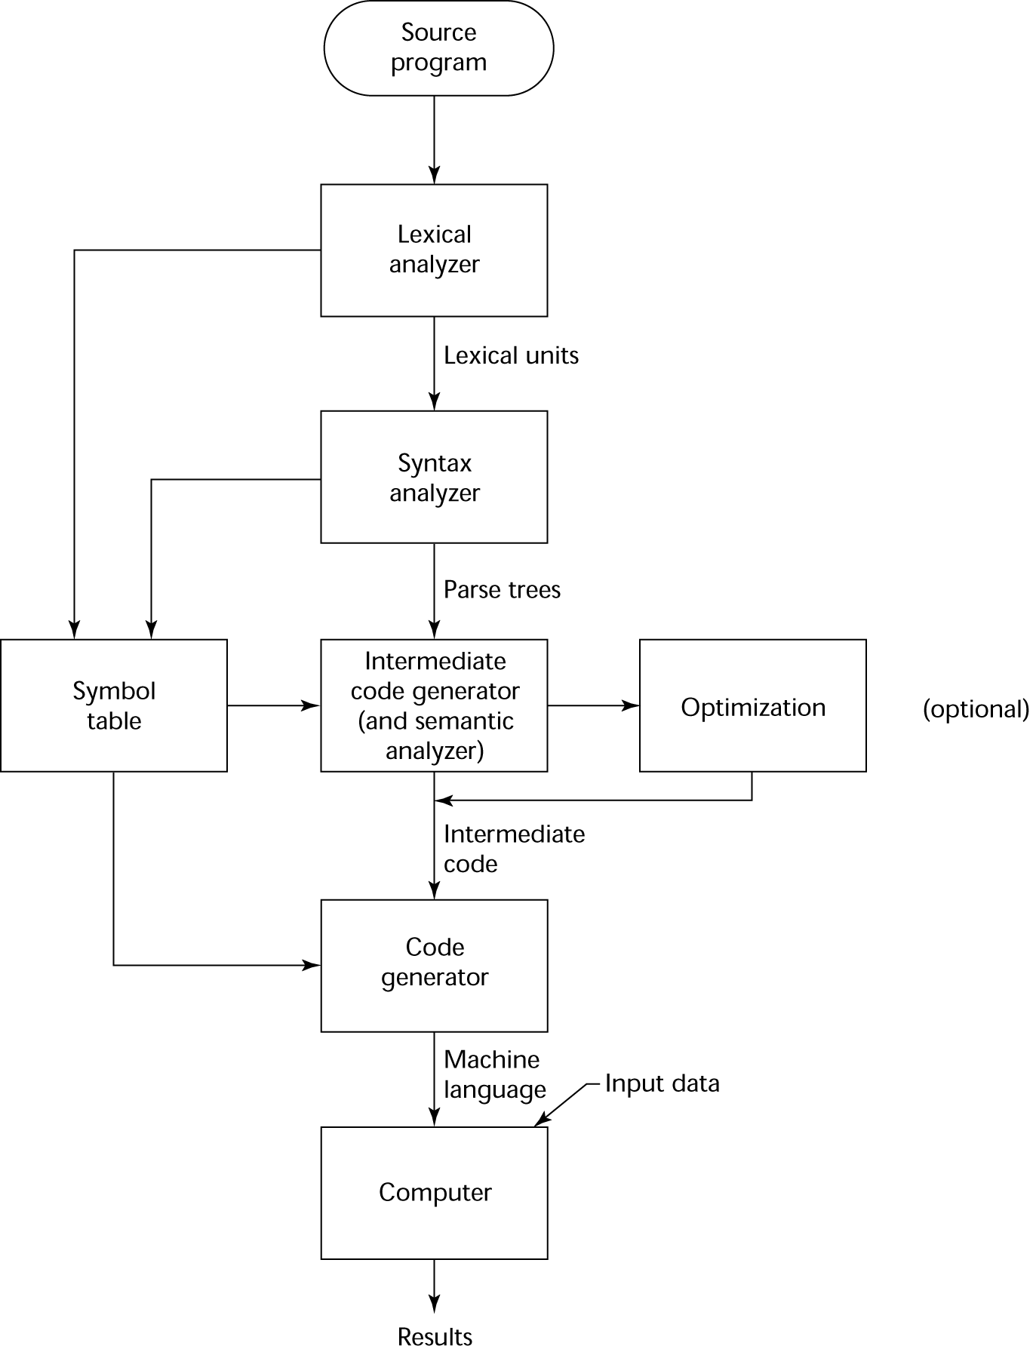
Computational Efficiency
Two types of efficiency
Computational efficiency: efficiency of the target code
Example: static data typing, enforced at compile time, means that the runtime does not need to check the data types before executing operations
Where do you check data types?

Slide 7
Programmer Efficiency
Programmer efficiency: how quickly and easily can a person read and write in the programming language?
Many aspects of programmer efficiency
  Expressiveness: how easy is it to express complex processes and structures?
  Conciseness of the syntax also contributes to programmer efficiency
    Example: Pascal has BEGIN END, C/Java have { }
    Block Structure in general

Slide 8
Programmer Efficiency
Aspects of programmer efficiency; cont
  Writability: the quality of a language that enables a programmer to use it to express computation clearly, correctly, concisely, and quickly
  Readability: how easy is it to comprehend the computations in a program?
    COBOL attempted to improve readability of programs by trying to make them look like ordinary English
    What about Java?
Notes:
HINT: COBOL attempted. It’s actually awful. It’s also a very early language. Got some COBOL coming right up
Applescript also did this. Any language which does this will suck!

Slide 9
COBOL Efficiency Example
PROCEDURE CALCULATOR.
Calculator.
PERFORM 3 TIMES
DISPLAY "Enter First Number : " WITH NO ADVANCING
ACCEPT Num1
DISPLAY "Enter Second Number : " WITH NO ADVANCING
ACCEPT Num2
DISPLAY "Enter operator (+ or *) : " WITH NO ADVANCING
ACCEPT Operator
IF Operator = "+" THEN
ADD Num1, Num2 GIVING Result
END-IF
IF Operator = "*" THEN
MULTIPLY Num1 BY Num2 GIVING Result
END-IF
DISPLAY "Result is = ", Result
END-PERFORM.
STOP RUN.

Slide 10
COBOL Efficiency Example
#Same code in Python
def calculator():
i = 0
while i < 3:
num1 = int(input("Enter First Number:"))
num2 = int(input("Enter Second Number:"))
op = input("Enter operator (+ or *)")
if op == "+":
result = num1 + num2
if op == "*":
result = num1 * num2
print("Result is =", result)
i = i + 1

Slide 11
Programmer Efficiency
Aspects of programmer efficiency; cont
  Reliability of a program can be viewed as an efficiency issue
    Unreliable programs require programmer time to diagnose and correct
  Programmer efficiency is also impacted by the ease with which errors can be found and corrected
  Since roughly 90% of time is spent on debugging and maintaining programs, maintainability may be the most important index of programming language efficiency
Notes:
SDLC
Software Development Life Cycle
Planning → Analysis → Design → Implementation → Maintenance
Write quick and debug horribly? Or write slower, but easy to debug?

Slide 12
Programmer Efficiency
Aspects of programmer efficiency; cont
  Reliability can be affected if restrictions are not imposed on certain features
    C: pointers basically unrestricted and thus prone to misuse and error
    Go: pointers are restricted to reduce security problems (e.g. no pointer arithmetic)
    Java: pointers were eliminated altogether (they are implicit in object allocation), but Java requires a more complicated runtime environment

Slide 13
Security
Security: A language designed with security in mind
  Discourages programming errors
  Allows errors to be discovered and reported
Types, type-checking, and variable declarations resulted from a concern for security
Exclusive focus on security can compromise the expressiveness and conciseness of a language
  Typically forces the programmer to laboriously specify as many things as possible in the code
Notes:
NOT cyber security
How well a language prevents a person from doing something invalid or that can't happen
ADA is an example of this. Verbose but you get more compile errors rather than runtime errors.

Slide 14
Security
Semantically safe: languages that prevent a programmer from compiling or executing any statements or expressions that violate the language definition
  Example: array out of bounds exception (or lack of it in C/C++ languages)
  Languages semantically safe: Python, Lisp, Java
Notes:
“Prevention” can equal a crash or an exception thrown
Spectrum, C are insecure so C hang with rope, it let you reck havoc. Array out of bounds, it doesn't tell where or how it happened, and let's you overwrite say the stack
Java stops you, you can crash things, tells you if something goes wrong
Does the language or the programmer shoulder the responsibility that nothing goes wrong? Security vs efficiency? Is it worthwhile?
In the military? Maybe? In a random webpage? Maybe not?
Depends.

Slide 15
Regularity
Regularity: refers to how well the features of a language are integrated
Greater regularity implies:
  Fewer restrictions on the use of particular constructs
  Fewer strange interactions between constructs
  Fewer surprises in the way the language features behave
Languages that satisfy the criterion of regularity are said to adhere to the principle of least astonishment
  Human languages (especially English) have many irregularities
Language constructs should be simple to understand with few ambiguities
Notes:
E.g. a symbol that does a thing should consistently do the same thing throughout the program to be considered regular

Slide 16
Regularity
Regularity refers to three (somewhat overlapping) concepts:
  Generality: achieved by avoiding special cases in the availability or use of constructs and by combining closely related constructs into a single more general one
  Orthogonal design:
    Constructs can be combined in any meaningful way, with no unexpected restrictions or behaviors
    Constructs should behave the same when used in different contexts
  Uniformity: a design in which similar things look similar and have similar meanings while different things look different

Slide 17
Generality
Generality: A language with this property avoids special cases wherever possible
Example: operators – should be applied consistently and to new data types
  In C, cannot directly compare two structures with ==, so this operator lacks generality
  What about Java?
Notes:
Java you can compare the two structures but it compares their identity not their equality
What are some limitations?

Slide 18
Orthogonality
Orthogonal design allows language constructs to be combined in any meaningful way with no unexpected restrictions or behaviors arising as a result of the interaction of the constructs
In a language that is truly orthogonal, constructs do not behave differently in different contexts
Orthogonality | VS | Generality
Restrictions that are context dependent are non-orthogonal |  | Restrictions that apply regardless of context exhibit a lack of generality
Notes:
Orthogonal design: Think of this as context should be ORTHOGONAL to behavior of a construct

Slide 19
Lack of Orthogonality
Example: Function Return Types
  Pascal allows only allows scalar or pointer types as return values
  C and C++ allows values of all data types except array types
  Ada and Python allow all data types
Example: Placement of Variable Declarations
  C requires that local variables be defined only at the beginning of a block
  C++ allows variable definitions at any point inside a block prior to use
Notes:
Orthogonal or not?
Not orthogonal
Not orthogonal
Orthogonal
Not orthogonal
orthogonal

Slide 20
Lack of Orthogonality
Example: Primitive and Reference Types
  In Java, primitive types use value semantics (values are copied during assignment), while object types (or reference types) use reference semantics (assignment produces two references to the same object). Only arrays can contain primitive types; other collections (e.g. ArrayList) must contain objects.

Slide 21
Uniformity
Uniformity: refers to the consistency of appearance and behavior of language constructs
  Lack of uniformity:
    Same things look different
    Different things look the same
  Deals with syntactical structure

Slide 22
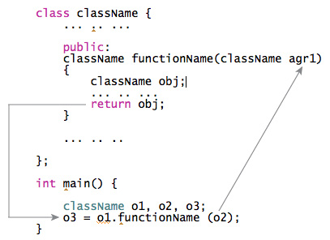
Lack of Uniformity
Same things look different
  C++ requires a semicolon after a class definition but forbids its use after a function definition
  Class definition
Notes:
Does this for compatibility with C for some reason

Slide 23
Lack of Uniformity
Different things look the same
  Pascal uses the function name in an assignment statement to return the function’s value
  Other languages use a return statement
1 2 3 4 5 6 7 8 9 | function gcd(x,y:longint):longint; begin while x<>y do begin if (x>y) then x := x-y else y := y-x; end; gcd := x; end;
Notes:
Modern languages do their best to avoid uniformity issues, so we go to the past.
Recursive call? Yikes! Seasoned pascal programmers can tell you easily, but new people? nope

Slide 24
Lack of Uniformity
Different things look the same
  C use of *
    Multiplication
      multiply = first * second;
    Dereferencing pointers
      int n = 50 , x ;
      int *ptr ; // Un-initialized Pointer
      ptr = &n; // Stores address of n in ptr
      x = *ptr; // Put Value at ptr in x
Notes:
a = *p * *b

Slide 25
Causes of Irregularity
Many irregularities are case studies in the difficulties of language design
Example: extra semicolon problem in C++ was a byproduct of the need to be compatible with C
Example: irregularity of primitive types and reference types in Java is the result of the designer’s concern with efficiency
Notes:
Python, everything is an object. In Java, that was scary, in 1990s, people were worried about efficiency and people were still used to C
Sacrifice regularity for Computational efficiency

Slide 26
Extensibility
Extensibility: a language that allows the user to add features to it
Example: the ability to define new data types and new operations (functions or procedures)
Extend built-in features with new releases – Java and Python
Allow user defined types – C++, Java, etc.
Very few languages allow additions to the syntax and semantics
  Lisp allows new syntax and semantics via a macro
  Macro: specifies the syntax of a piece of code that expands to other standard code when compiled

Slide 27
Language Design Criteria Review
Efficiency
  Computational and programmer efficiency
Security - How easy it is to do something illegal
Regularity – rule of least astonishment
  Generality – No restrictions regardless of context
  Orthogonal Design – behavior is consistent across contexts
  Uniformity – symbols behave the same throughout language
Extensibility – how much / easily you can add to the language

Slide 28
Abstractions in Programming Languages
Two types of programming language abstractions:
  Data abstraction - simplify the behavior and attributes of data for humans
    Examples: numbers, character strings, search trees
  Control abstraction - simplify properties of the transfer of control
    Examples: loops, conditional statements, procedure calls
Notes:
We don’t care how the computer stores the numeric value 2.8, we just care that it stores that value
We don’t need to manually loop our code, we can use a control structure instead

Slide 29
Abstractions in Programming Languages
Abstractions can also be categorized by levels (measures of the amount of information contained or hidden in the abstraction)
Basic abstractions: collect the most localized machine information
Structured abstractions: collect intermediate information about the structure of a program
Unit abstractions: collect large-scale information in a program
Notes:
We’re about to dive into detail

Slide 30
Data: Basic Abstractions
Basic data abstraction:
  Hides internal representation of common data values
    Values are also called “primitive” or “atomic” because the programmer cannot normally access the component parts or bits of the internal representation
  Variables: use of symbolic names to hide computer memory locations containing data values
  Data types: names given to kinds of data values
  Declaration: the process of giving a variable a name and a data type
  Standard mathematical operations, such as addition and multiplication

Slide 31
Data: Structured Abstractions
Data structure: collects related data values into a single unit
  Hides component parts but can be constructed from parts, and parts can be accessed and modified
Examples:
  Structure/Record: Collection of elements of possibly different types, (Ex: Employee record contains name, address, phone, salary (different data types)
  Array: sequence of individually indexed items with the same data type
  Text file: a sequence of characters for transfer to and from an external storage device

Slide 32
Data: Unit Abstractions
Information hiding: defining new data types (data and operations) that hide information
Unit abstraction is often associated with the concept of an abstract data type
  A set of data values and the operations on those values
  Separates the interface from the implementation
    Interface: set of operations available to the user
    Implementation: internal representation of data values and operations
  Ex: package, class, module

Slide 33
Data: Unit Abstractions
Unit abstraction also provides reusability
Typically, components are entered into a library and become the basis for library mechanisms
  Interoperability allows combination of units
Application programming interface (API): gives information about the resource’s components
Notes:
Black Box Programming
Programming via contract
Blackbox programming, foundation of using other people's code, breaking stuff into sub problems!
Imagine if you had to understand a car to drive it…

Slide 34
Abstractions in Programming Languages
Two types of programming language abstractions:
  Data abstraction - simplify the behavior and attributes of data for humans
    Examples: numbers, character strings, search trees
  Control abstraction - simplify properties of the transfer of control
    Examples: loops, conditional statements, procedure calls
Notes:
End of Data start transitioning to control
We don’t care how the computer stores the numeric value 2.8, we just care that it stores that value
We don’t need to manually loop our code, we can use a control structure instead

Slide 35
Abstractions in Programming Languages
Abstractions can also be categorized by levels (measures of the amount of information contained or hidden in the abstraction)
Basic abstractions: collect the most localized machine information
Structured abstractions: collect intermediate information about the structure of a program
Unit abstractions: collect large-scale information in a program
Notes:
We’re about to dive into detail

Slide 36
Control: Basic Abstractions
Basic control abstractions: statements that combine a few machine instructions into an abstract statement that is easier to understand
  Use of algebra
  Ex: sum = num1 + num2
Syntactic sugar: a mechanism that allows you to replace a complex notation with a simpler, shorthand notation
  Ex: x += 10 instead of x = x + 10

Slide 37
Control: Structured Abstractions
Structured control abstractions: divide a program into groups of instructions nested within tests that govern their execution
  Help to express the logic of primary control structures of sequencing, selection, and iteration
Branch instructions: instructions that support selection and iteration to memory locations other than the next one

Slide 38
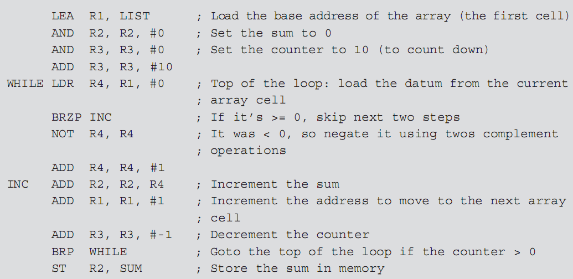
Control: Structured Abstractions - Assembly
Notes:
ARM Assembly? LC-3 Assembly? lol
Adding absolute values of a list of numbers

Slide 39
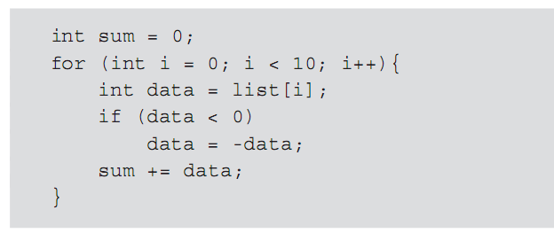
Control: Structured Abstractions – Java

Slide 40
Control: Structured Abstractions
Function (or method or procedure or subroutine): groups a sequence of actions into a single action that can be called or invoked from other points in the program
  Function declaration: names a procedure and associates it with the actions to be performed
  Invocation: the act of calling the procedure
  Parameters: values that can change from call to call
  Arguments: values supplied by the caller for the parameters
While all above terms are commonly used interchangeably, there are formal differences:
  Function → defined in a class, returns a value
  Method → defined in a object, returns a value
  Procedure → defined in a class, no return value
  Subroutine → assembly programming for procedure
Notes:
Function returns something, a procedure doesn’t, but they are basically the same thing: This is the FORMAL difference

Slide 41
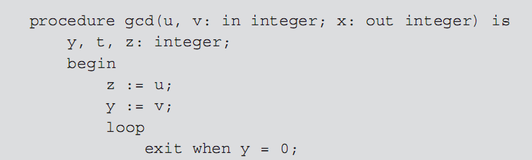
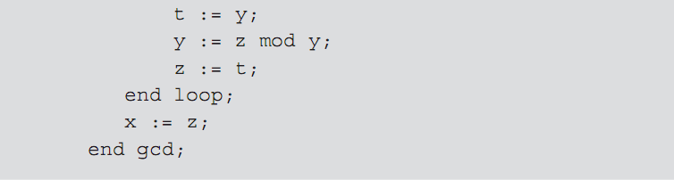
Control: Structured Abstractions

Slide 42
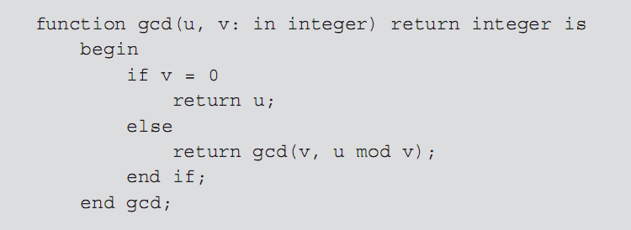

Control: Structured Abstractions

Slide 43
Control: Unit Abstractions
Unit: a stand-alone collection of procedures providing logically related services to other parts of a program
  Allows a program to be understood as a whole without needing to know the details of the services provided by the unit
  Same a unit level data abstraction, but focus is on the operations
Threads: separately executed control paths within the Java system
Processes: other programs executing outside the Java system for parallel processing

